Slide 1


Project
Analytics
Part 1

Slide 2
Problem Statement
Nitin works as a Graphic Designer in a new company. He earns Rs 15,000/- per month. He is planning to buy a scooter for his daily commute to the office.
For the last couple of months, Nitin is not able to save at all for his scooter. His friend Ayush told him that he needed to figure out where most of the money goes and cut down that expense.
Help Nitin increase his savings by removing some unnecessary expenses.

Slide 3

ABOUT DATASET
DATASET FOR JUNE MONTH - 👇
June Month
DATASET FOR 6 MONTH - 👇
6 Month

Slide 4
Tasks Part -1
The category with the highest expense amount
Total expense amount against entertainment and shopping
Number of times Nitin has ordered food online and the amount spent for it
Number of times Nitin has watched a movie
The less essential category that Nitin may remove to increase his savings

Slide 5
Task Results- Part 1 Tables
The category with the highest expense amount.
Grocery 4690
Total expense amount against entertainment and shopping
Entertainment | 1000
Shopping | 3500
Number of times Nitin has ordered food online and the amount spent for it
Online Food Order | 4 (tImes)
Total Amount Spent | 600 (INR)
Number of times Nitin has watched a movie
Movie | 4 (times)
The less essential category that Nitin may remove to increase his savings
Movie
Online Food Order

Slide 6
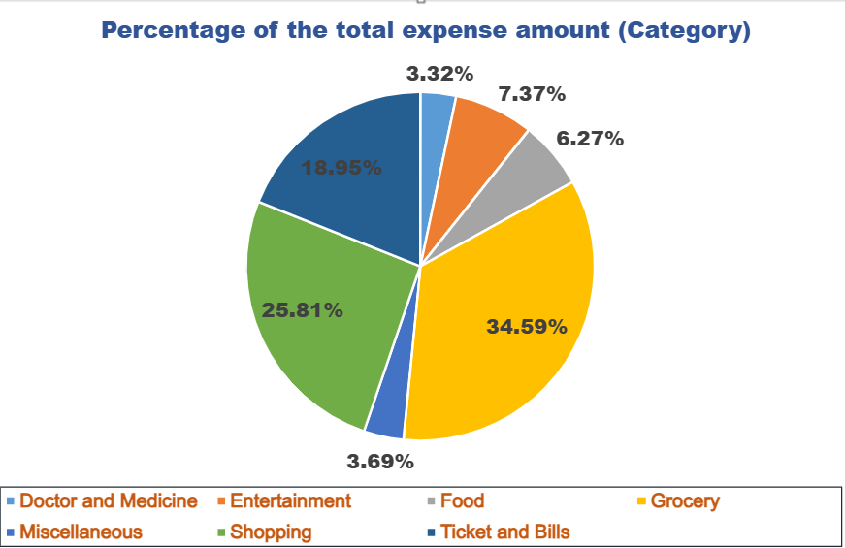
Tables and Charts Part-1
Spent for each category (PivotTable)
Category | Total Expense (INR)
Doctor and Medicine | 450
Entertainment | 1000
Food | 850
Grocery | 4690
Miscellaneous | 500
Shopping | 3500
Ticket and Bills | 2570

Slide 7
Project
Analytics
Part 2

Slide 8
Problem Statement
In Part 1, you have analysed expense details for a single month. ​​
Now, in Part 2, you need to analyse the expense data for the last 6 months. Open the excel file and analyse the given expense details for the last 6 months. ​

Slide 9
Tasks Part -2
The month-wise trend of expenses and find out the month Nitin spent the most
Visual representation of expenses against different categories
Top 2 categories with higher expenses for each month
Recommendations on how can Nitin increase his savings

Slide 10
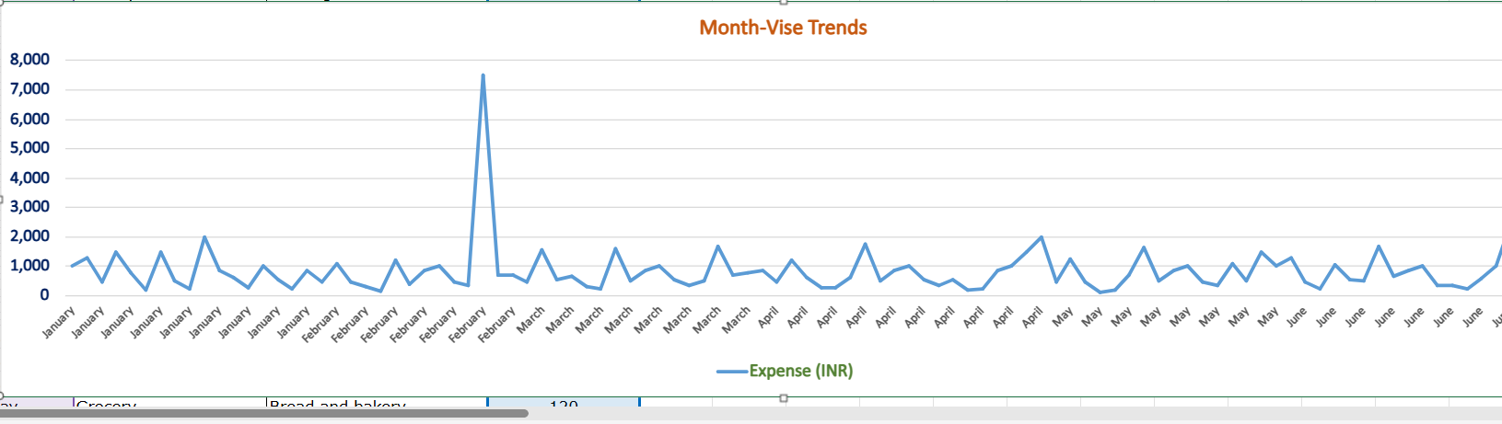

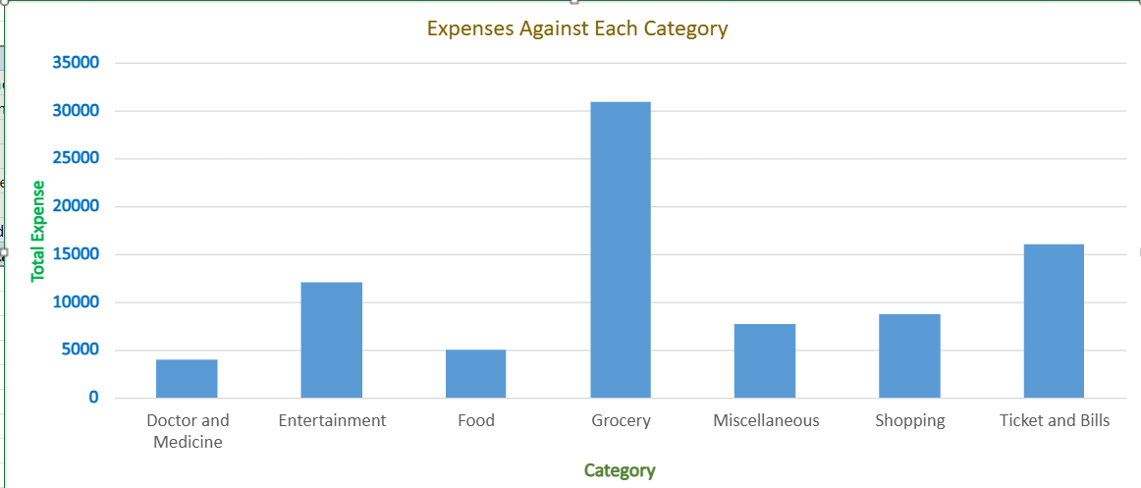


MOST SPENT MONTH
CATEGORY MOST SPENT
GROCERY
TICKETS AND BILLS

Slide 11
KPI
Nitin spent most of 2nd highest on category tickets and bills this can be movie tickets and other types of bills nitin needs to reduce the money spent on these bills.Nitine also spending 34% monry on grocery so why he is ordering online foods to more savings he can reduce the money in these category.

Slide 12
THANK YOU !​
​
​

